Slide 1

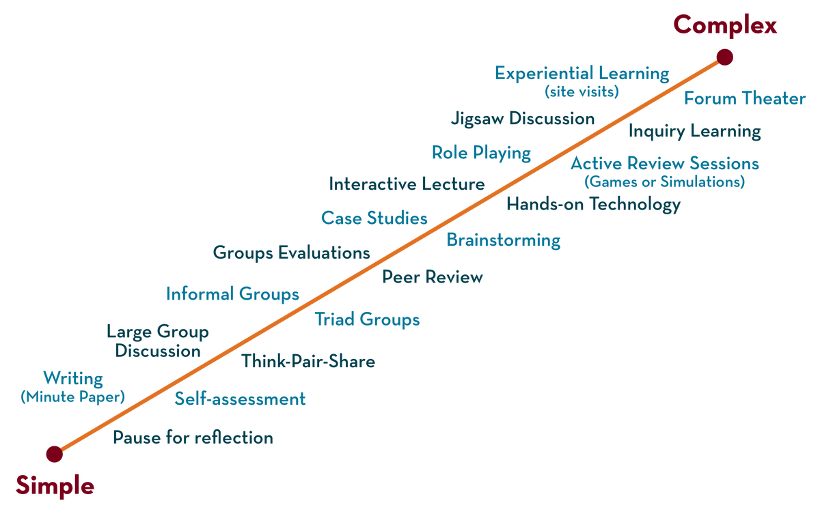
Department of CSE
FRONT END WEB DEVELOPMENT (EPAM)
21CS3017AA/21CS3017PA
Topic:
Git Basics
Session - 1

Slide 2



AIM OF THE SESSION
To familiarize students with the basic concept of GIT CLI commands
INSTRUCTIONAL OBJECTIVES
This Session is designed to:
Demonstrate the basic commands in GIT CLI
LEARNING OUTCOMES
At the end of this session, you should be able to:
Apply the commands and understand the process of working.

Slide 3
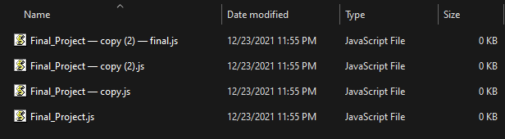
SESSION INTRODUCTION
WE ALL DID THIS AT LEAST ONCE …

Slide 4
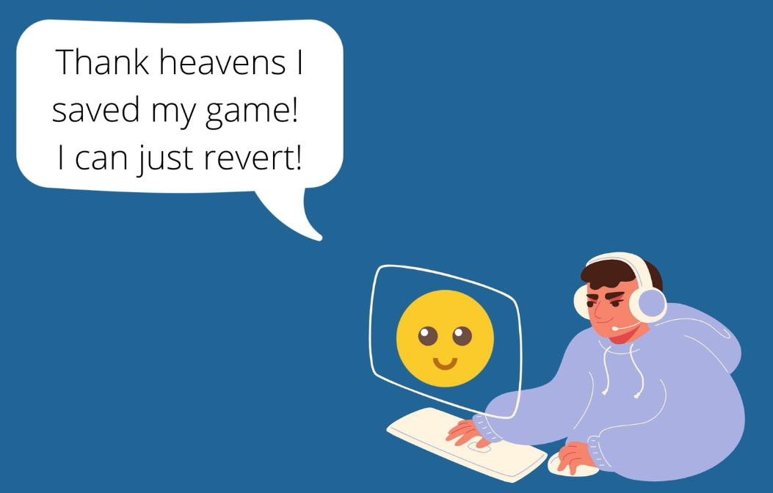
SESSION DESCRIPTION
WHAT IS VERSION CONTROL?
VC, also known as source control, is a software that tracks and manages changes to files over time. Allows revisit earlier versions of the files, compare changes between versions, undo changes, etc.
Main features:
• Track changes across multiple files
• Compare versions of a project
• “Time travel” back to old versions
• Revert to a previous version
• Collaborate and share changes
• Combine changes

Slide 5
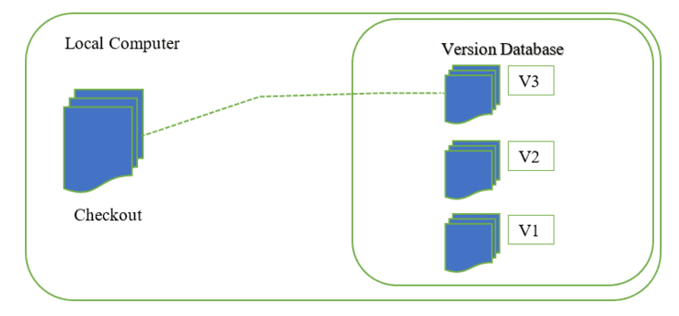
SESSION DESCRIPTION (Cont..)
LOCAL VERSION CONTROL SYSTEM
A local version control system is a local database located on your local computer, that keeps all the changes to files under revision control. One of the most popular VCS tools was a system called RCS, which is still distributed with many computers today.
RCS works by keeping patch sets (that is, the
differences between files) in a special format on disk; it can then re-create what any file looked like at any
point in time by adding up all the patches.
Disadvantages:
• If anything were to happen to the local database, all
the patches would be lost.
• If anything were to happen to a single version, all
the changes made after that version would be lost.
• Collaborating with other developers or a team is
very hard or nearly impossible.

Slide 6
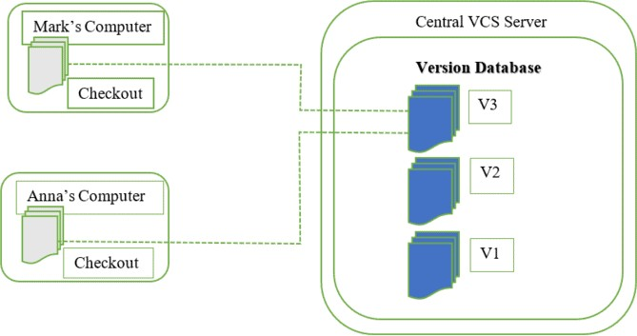
CENTRALIZED VERSION CONTROL SYSTEM
SESSION DESCRIPTION (Cont..)
A centralized version control system has a single server that contains all the file versions. This enables multiple clients to simultaneously access files on the server, pull them to their local computer or push them onto the server from their local computer. This way, everyone usually knows what everyone else on the project is doing. Administrators have control over who can do what.
Examples of CVCS are TFS (Microsoft Team Foundation) and
SVN.
Disadvantages:
If the main server goes down, developers can’t save
versioned changes
If the central database is corrupted, the entire history
could be lost (security issues)
Slow speed delays development

Slide 7
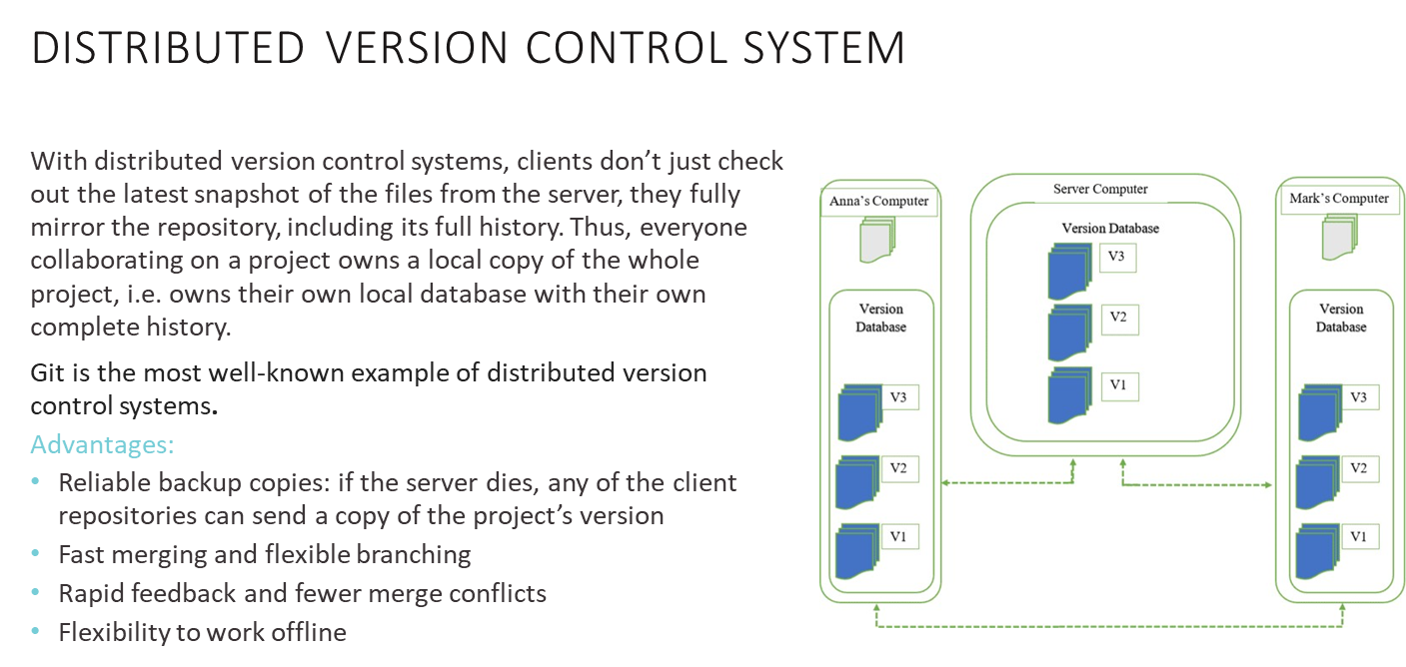
SESSION DESCRIPTION (Cont..)

Slide 8
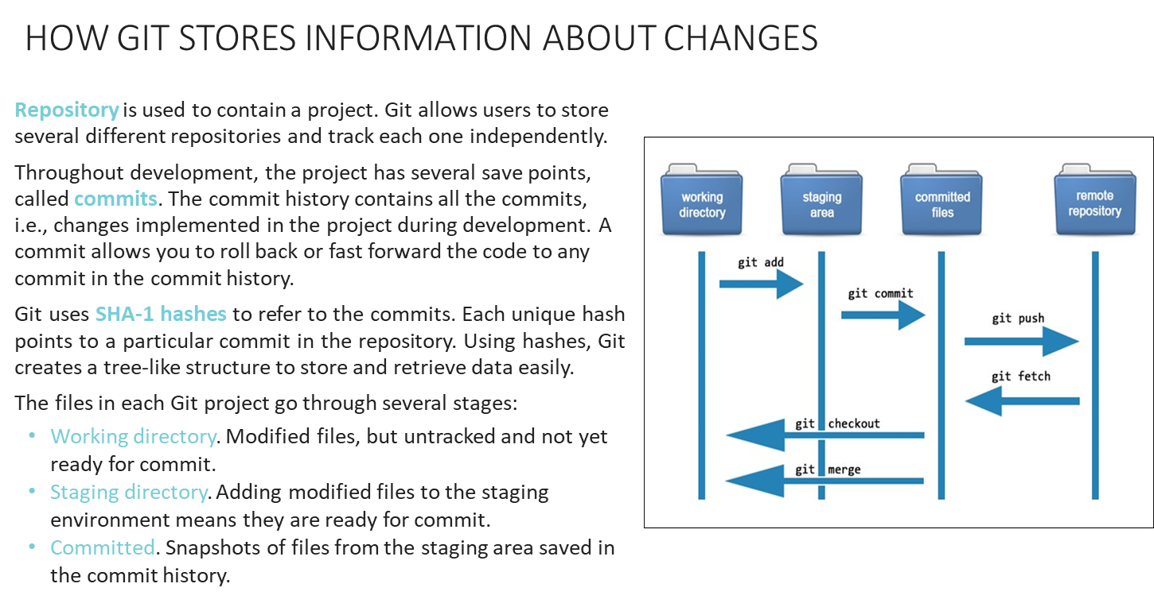
SESSION DESCRIPTION (Cont..)

Slide 9
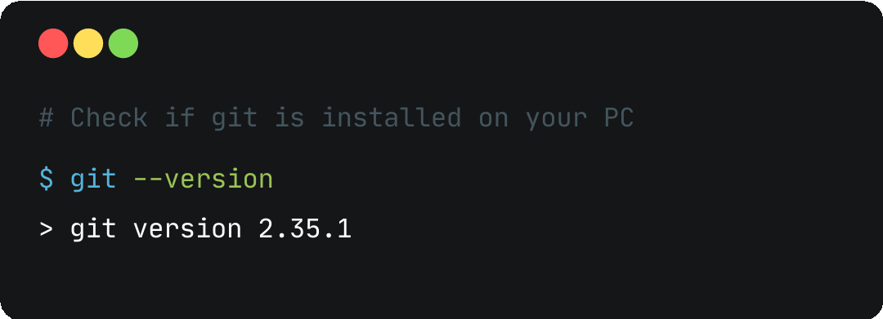
INITIAL GIT SETUP: INSTALL GIT
SESSION DESCRIPTION (Cont..)
In case git is not installed, download GIT according to your OS here:
https://git-scm.com/downloads

Slide 10
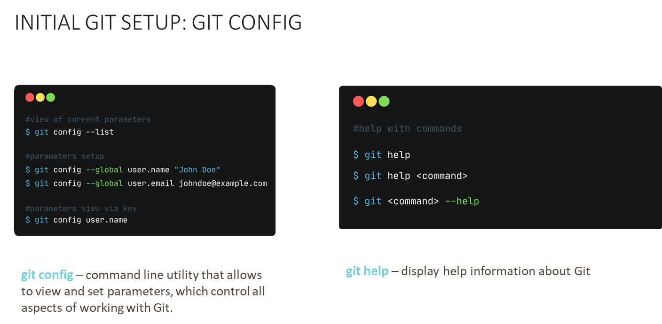
SESSION DESCRIPTION (Cont..)

Slide 11
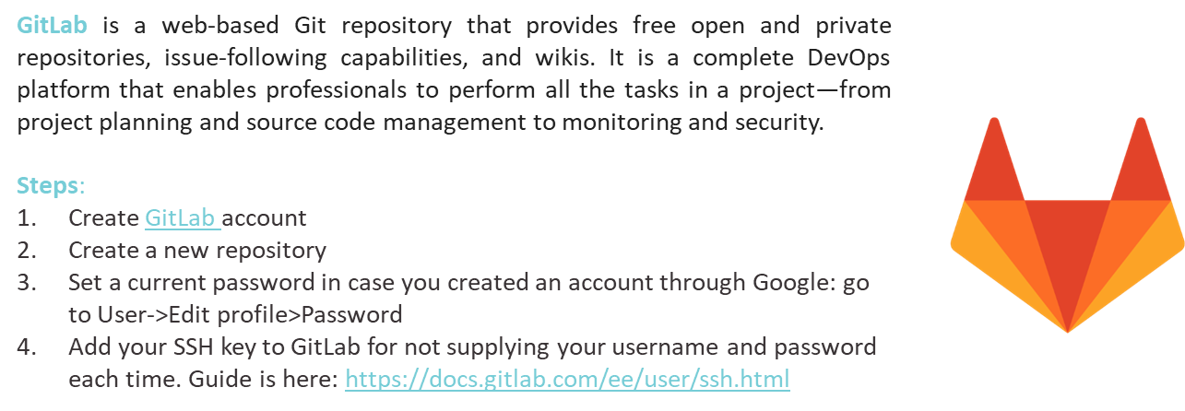
SESSION DESCRIPTION (Cont..)

Slide 12
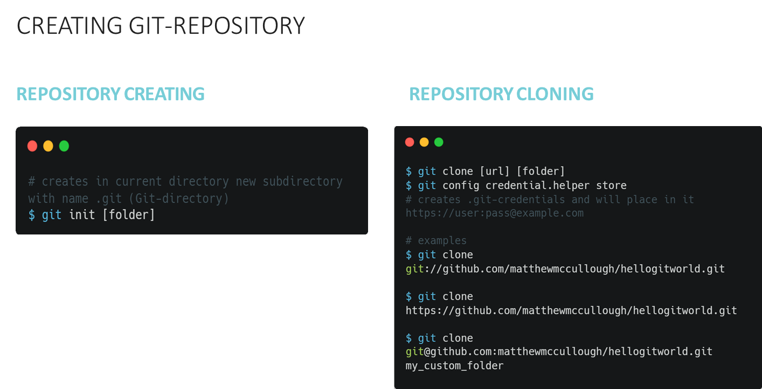
SESSION DESCRIPTION (Cont..)

Slide 13
SESSION DESCRIPTION (Cont..)

Slide 14
SESSION DESCRIPTION (Cont..)

Slide 15
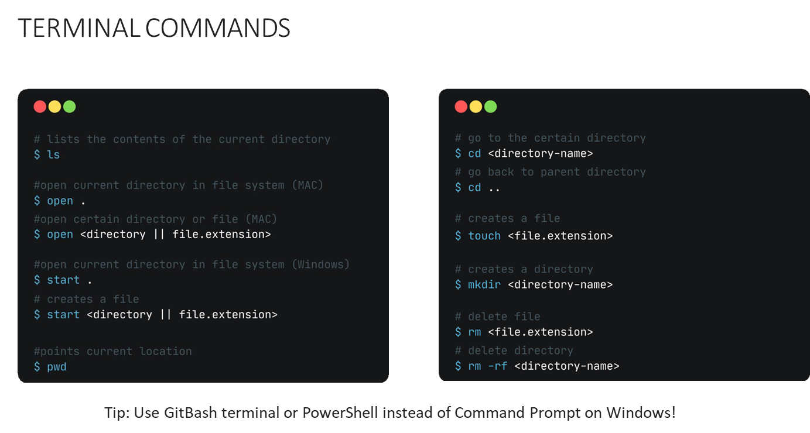
SESSION DESCRIPTION (Cont..)

Slide 16
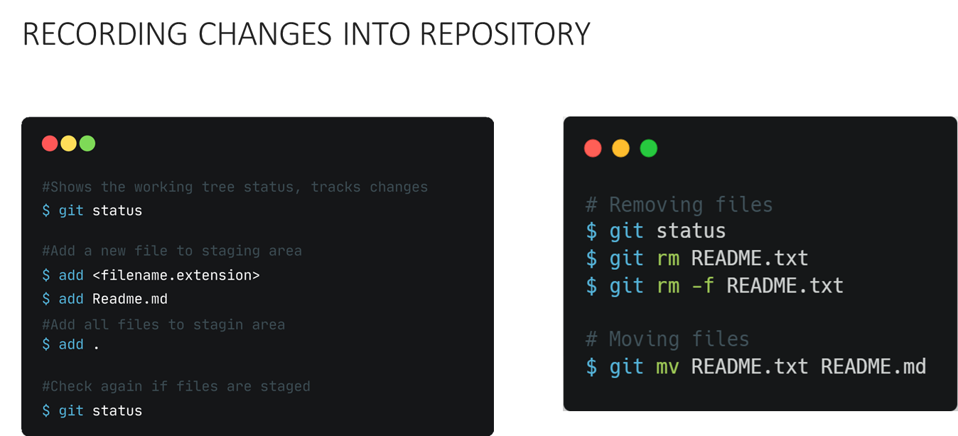
SESSION DESCRIPTION (Cont..)

Slide 17
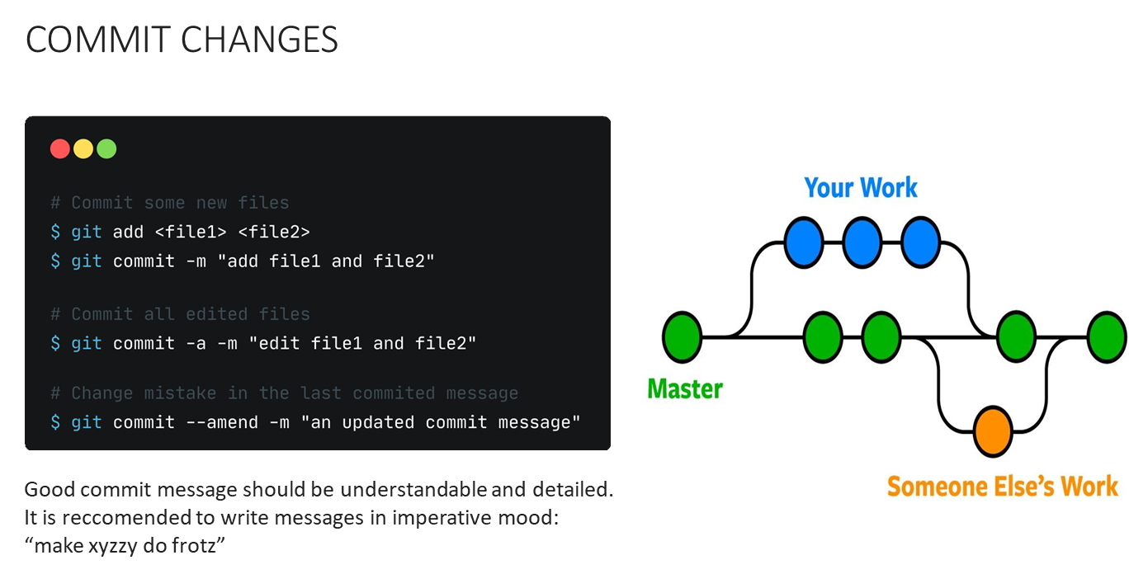
SESSION DESCRIPTION (Cont..)

Slide 18
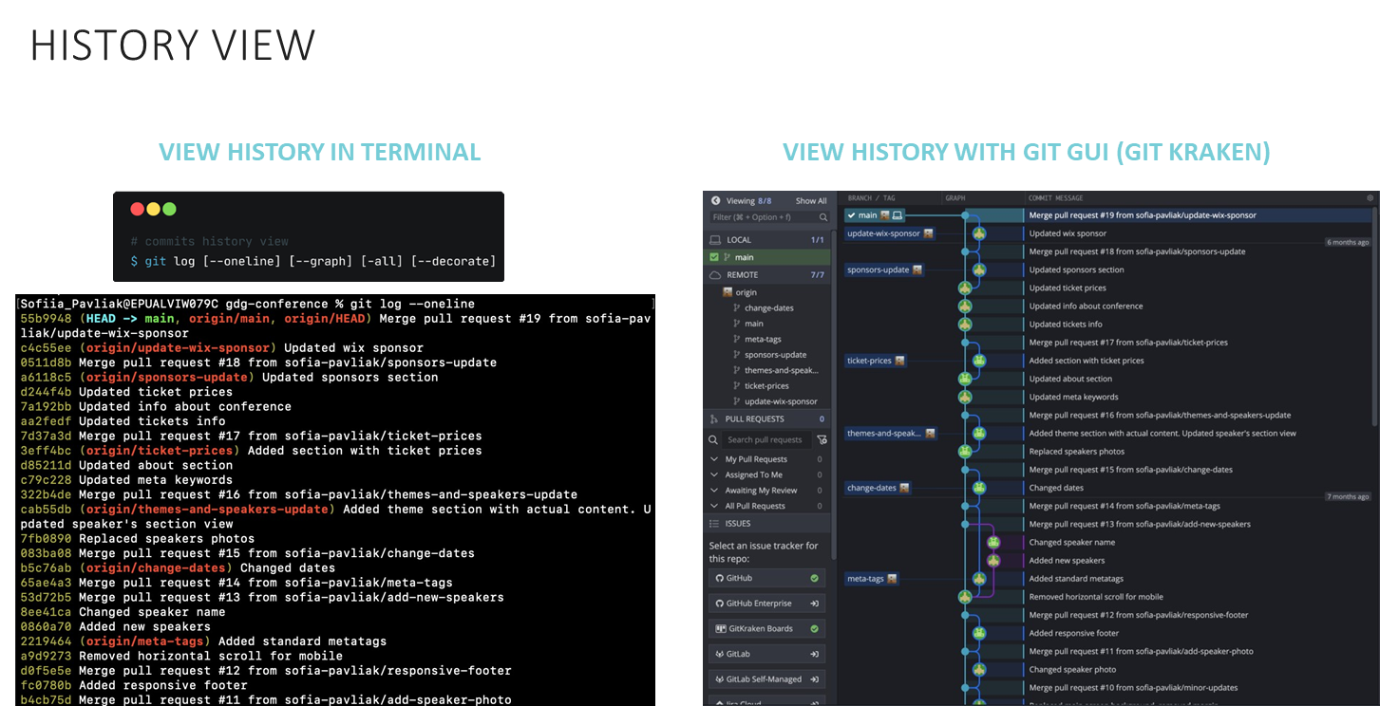
SESSION DESCRIPTION (Cont..)

Slide 19
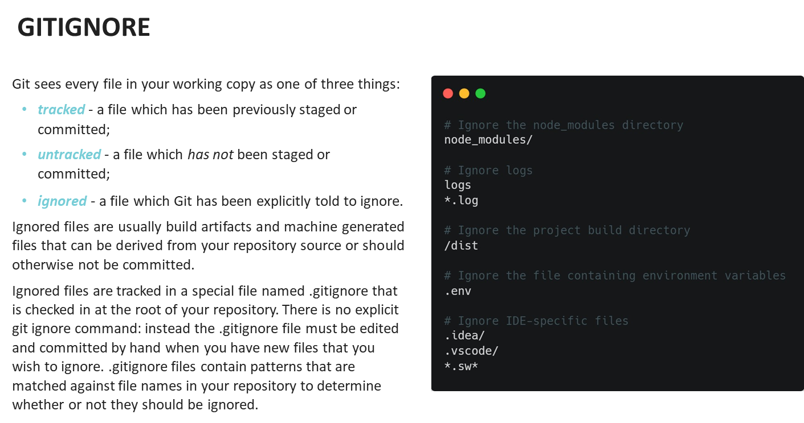
SESSION DESCRIPTION (Cont..)

Slide 20
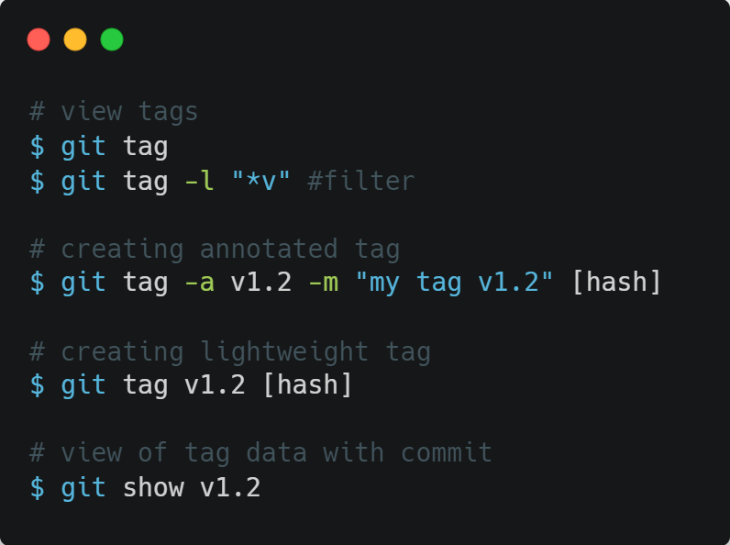
GIT TAG
SESSION DESCRIPTION (Cont..)
Git allows to tag specific moments in commits history as important. As a rule, tags are used for identifying version issue moment.
Tags can be of 2 types:
Annotated – user information, date etc
are stored
Lightweight – only tag name is stored

Slide 21
SUMMARY
Apply the commands for initialization of Git Repository
Apply the commands for Clone the external Git Repository
You should have a basic understanding of what Git is and how it’s different from any centralized version control systems you may have been using previously.
You should also now have a working version of Git on your system that’s set up with your personal identity. It’s now time to learn some Git basics.

Slide 22
THANK YOU
Team – Course Name

